Slide 1
Important Reminders

Slide 2

Classroom/Laboratory Rules
This classroom is classified as a science laboratory, so food and drink are not permitted.
If you do bring food or drink, they need to be kept stored in your backpack and consumed outside of the class.
Food and drinks should never be on the table top.
Please be aware of your surroundings and others around you.
Please push your chair in when class is dismissed.

Slide 3
IMPORTANT REMINDERS
Communication (email)
Please take the time to add a subject to all your emails and be specific with your questions. Ex: ENGR 102.556: Assignment 1B – Activity 2.A
Please do not use nicknames on your assignments. This makes it more challenging to identify who I’m corresponding with. Also, if it’s not in my gradebook, your assignment will not be graded.
Please be professional with your words. Cussing and slang is never acceptable in any context.

Slide 4
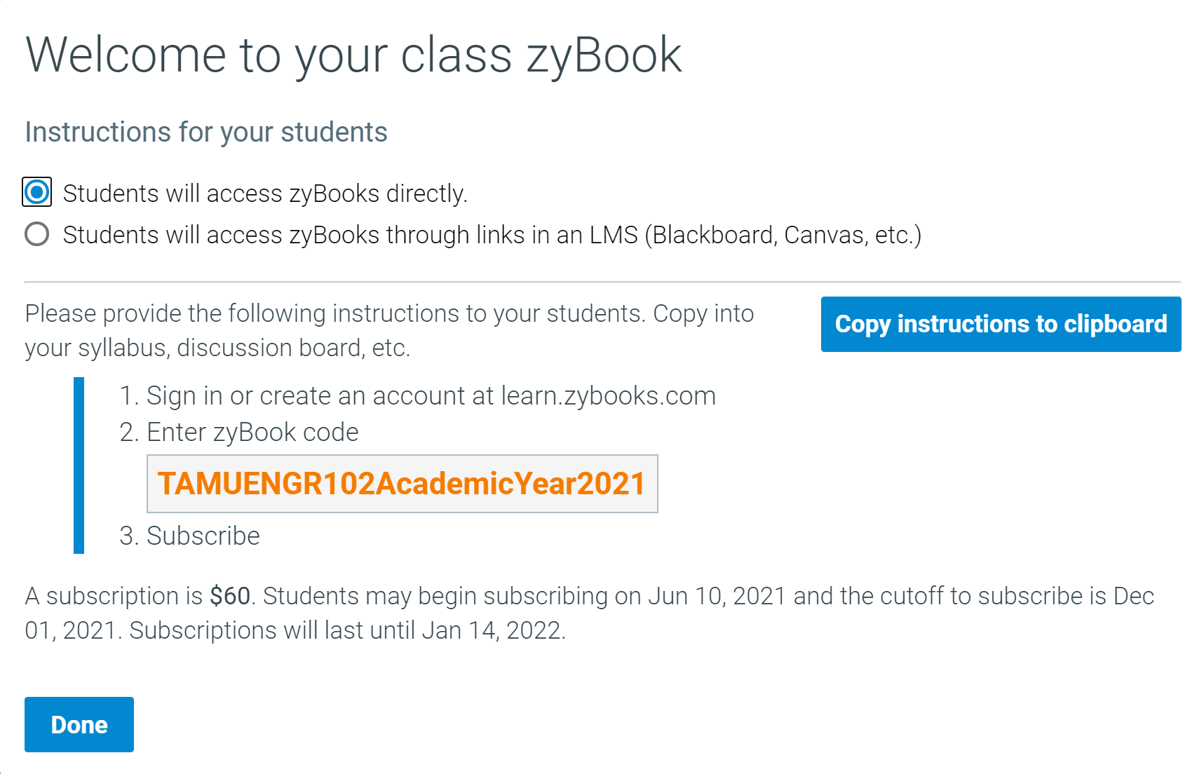
IMPORTANT REMINDERS
The Zybook is a required resource. The sequence to follow is to complete the chapter before lecture so that you
have a better understanding of the material being covered that particular day.
Be sure that you enter the correct section number (556) or I will not be able to extract your grades.

Slide 5

IMPORTANT REMINDERS
Please utilize comments in your programs. This will be extremely helpful in the future and help remind you of important things throughout your program.
ENGR 102 Multi-section is now live (albeit with limited functionality). This is where you can find the engineering modules/quizzes. More information to follow once it is fully operational.
Recall, the study ratio to class time is at least 3:1. This means 6 hours, minimum of outside study time. Create a weekly study plan.
Download Kahoot to your mobile device and have it ready for daily quizzes beginning next week.

Slide 6

How to save and upload your files For right now this will be our process. This will be updated as soon as I have access to Mimir.

Slide 7


Assignment Storage Protocol
WEEKLY LECTURE SLIDES
LAB 1A
INSTRUCTIONS
LAB 1B
INSTRUCTIONS
WEEK 1
.
.
.
LAB 1A PYTHON PROGRAM CODE
LAB 1B PYTHON PROGRAM CODE
LAB 1A PROGRAM CODE AND OUTPUT
SCREENSHOT (WORD)
LAB 1B PROGRAM CODE AND OUTPUT
SCREENSHOT (WORD)

Slide 8
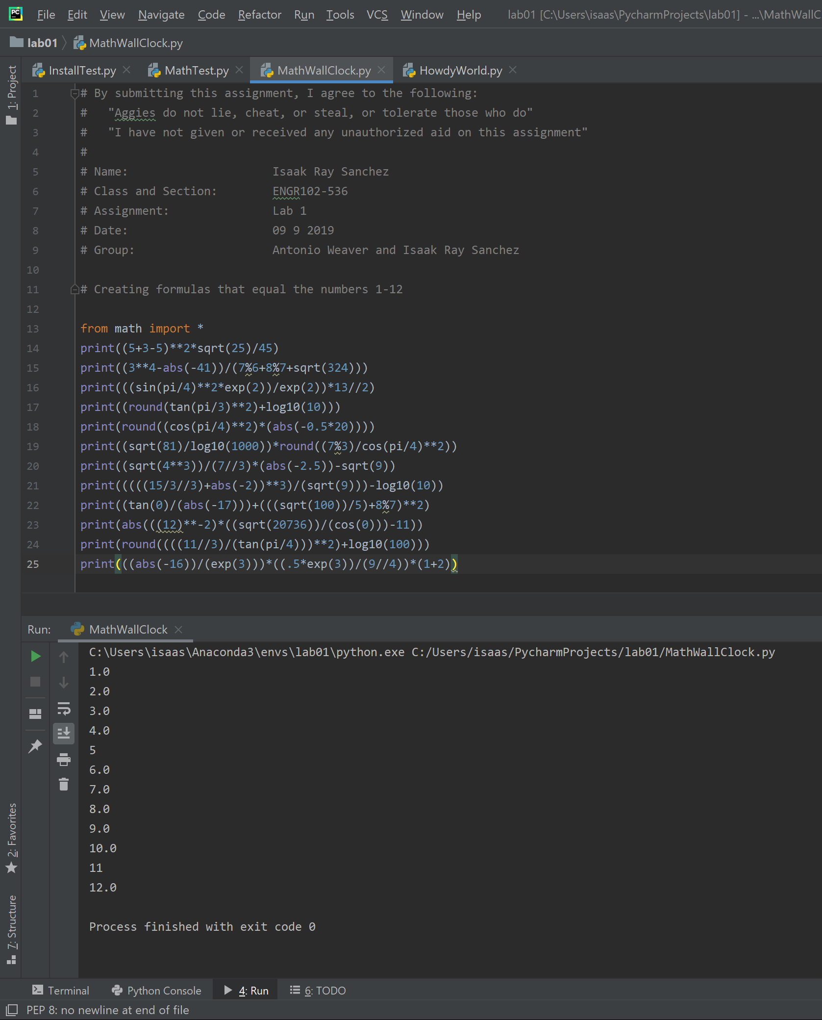
Assignment Upload Protocol
You need to have the following assignment header on all of your assignments. Any assignment turned in without it will not be graded…no exceptions.
################################################### # By submitting this assignment, I agree to the following:
# “Aggies do not lie, cheat, or steal, or tolerate those who do” # # Name(s): # Class and Section:
# Assignment:
# Date: # Group:
###################################################

Slide 9
Lecture 2
Sequential Steps, Variables, Assignment

Slide 10
Goals for today
Variables
Assignment
Sequential Steps

Slide 11
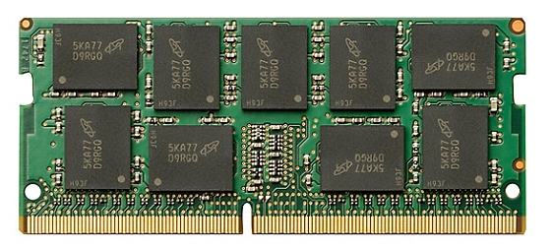
Computer Memory
If we can’t remember things, we can’t actually do very much
Computers have memory – the ability to remember information

Slide 12
Computer Memory
Offline Memory
(e.g. Cloud)
Slower to Access
More total data
More long-lasting
Secondary Memory (Files)
Computer memory is organized in a hierarchy
As you go higher in the hierarchy, the memory becomes slower to access, but you get more, and it is more permanent
Main Memory
Cache (near CPU)
Faster to Access
Less total data
Less permanent
CPU - registers

Slide 13
Computer Memory
Offline Memory
(e.g. Cloud)
Slower to Access
More total data
More long-lasting
Secondary Memory (Files)
When we say “memory”, we’ll be referring to “main memory”
Main Memory
Cache (near CPU)
Faster to Access
Less total data
Less permanent
CPU - registers

Slide 14
Computer Memory
Offline Memory
(e.g. Cloud)
Slower to Access
More total data
More long-lasting
Secondary Memory (Files)
Later in the course, we’ll talk about handling files
Main Memory
Cache (near CPU)
Faster to Access
Less total data
Less permanent
CPU - registers

Slide 15
Computer Memory
Offline Memory
(e.g. Cloud)
Slower to Access
More total data
More long-lasting
Secondary Memory (Files)
We’ll ignore the lowest levels of memory in this class.
Main Memory
Cache (near CPU)
Faster to Access
Less total data
Less permanent
CPU - registers

Slide 16
Main Memory
Main Memory
Think of main memory as being a bunch of “boxes” that hold information.
We will call these boxes of memory variables

Slide 17
Variables and Names
A variable (a box of memory) can hold some unit of information
e.g. a number, like the number 19
We need a way to refer to a particular variable, to distinguish it from the other boxes of memory. This will be the variable name.
e.g. age
Think of the name as the label for the box
19
age

Slide 18
The (Python) rules for naming
Names can start with a letter (lowercase or uppercase) or an underscore (_).
But, you generally shouldn’t start them with an _ since this tends to imply certain things about the variable.
The name can contain letters (lowercase or uppercase), numbers, and underscore characters.
The name cannot be a reserved keyword
These are special commands reserved for the language itself. They include words like “for” and “while”.
You will learn these as you learn to program.

Slide 19
Naming Variables and Constants
So you could name all your variables to minimize typing
e.g. a, b, c, …
But this would result in confusion later – what do these mean?
A better way of thinking about variable (and other) names you choose in code is to think of communicating with other people
You are communicating with anyone you are sharing the code with, including anyone who has to take over your code
This is done quite often in industry.
But most importantly to you, you are communicating with the future you – the you that will have forgotten many of the details of the code you are going back to after doing other things

Slide 20
The importance of variable names
Names help us understand the world, identify particular things, and so on.
In computers, the name of a variable distinguishes one particular box of memory.
But, a good name can give more information – about the purpose for that piece of memory.
Just because a name is valid, doesn’t mean it’s good.

Slide 21
Are these names valid and good?
abcde
Age
my_name
My_Name
MyName
2nd_name
name_2nd
Winner!
F0rTheW1n
_density
Gig’Em
Gig Em
Gig-Em
Gig_Em
Valid but not good (meaningless)
Valid and good
Valid and good
Valid and good (and different from previous)
Valid and good (and different from previous)
Not valid (starts with a number)
Valid, and probably good
Not valid (contains !)
Valid, but not good (digits are confusing)
Valid, probably not good (begins with _)
Not valid (contains ‘)
Not valid (contains a space)
Not valid (contains a -)
Valid, but probably not good (not clear what it contains)

Slide 22
More about naming
Generally, pick descriptive names
Volume might be a better choice than V
Not too long, though
Volume_of_the_sphere is probably too long
V_sphere, or VolSphere, or Vsphere, etc. might be better names
There are a few conventions people use:
Constants (that never change) often in ALL_CAPITALS
Variables i, j, and k often used for counting or indexing
Variables typically start with lower-case letters

Slide 23
Determining the Variables You Need: Mapping Problems to Software
Mapping problems to software representations involves answering a number of questions.
What question are you trying to answer using the software?
What are the characteristics of the problem that affect the outcome?
How do they affect the outcome and how do they interact?
Who is using the software you’re creating?
Answers to the second question are likely to help determining what variables your software will have
The other questions affect the design and the individual operations

Slide 24
Example Problem Taken from Your Own Life
One of the most important skills engineering students need is to be able to effectively allocate their time to their studies.
What questions do we want to answer?
How effective are many short, a middle number of medium-length, or a few long study sessions?
How might other aspects of ourselves affect the outcome?
What characteristics affect the outcome?
The length of study sessions
The number of study sessions
How tired, stressed, hungry, etc. you are

Slide 25
Names for our Study Session Problem
Important concepts/values
Time spent studying in a session
t – advantage is it is short, disadvantage is it is ambiguous with lots of other concepts
time – better, but this could be time of starting study session, time of day, etc.
length – more accurate, but could be confusing because most often associated with physical dimensions
session_length – even better, but what is the units (seconds, minutes, hours)
session_length_min – good try, but could be read as the minimum length of a session
session_length_minutes – pretty likely to be understood, of course, it is now a long name
Rate of learning concepts/skills
concepts_per_minute
Number of concepts learned in a session
concepts_learned_in_session
Writing software requires trade-offs
One that will be apparent throughout this course is the trade-off between ease of comprehension and compactness

Slide 26
Variable Values
When we see a variable name in a program, that is a placeholder for the value contained in that variable’s “box” of memory.
Example: say the variable “age” holds value 19.
What would be the value of age+3?
age+3 = 19+3 = 22
19
age

Slide 27
Assignment
The process of sticking a value into the box of memory is called assignment.
Can assign to any variable – new or old
When a new value is assigned to a variable, the old value is replaced by the new one
Can (and often does) happen many times for the same variable
19
Assign 30 to age
30
age
age

Slide 28
Assignment statements
Python assignment statements have the form:
<Variable name> = <Value to assign>

Slide 29
Assignment statements
Python assignment statements have the form:
<Variable name> = <Value to assign>
The left hand side is the variable name for the “box” in memory that will hold the value.
19
age

Slide 30
Assignment statements
Python assignment statements have the form:
<Variable name> = <Value to assign>
The = is the assignment operator.
It is NOT the “equals” sign, though we still often read it aloud as “equals”. We can read it aloud as “gets” or “is assigned.”
19
age

Slide 31
Assignment statements
Python assignment statements have the form:
<Variable name> = <Value to assign>
The right hand side of the assignment operator is the value that will be assigned to the box
19
age

Slide 32
Assignment statements
Python assignment statements have the form:
<Variable name> = <Value to assign>
When this statement is executed:
We FIRST evaluate the right hand side
Then, we assign that value to the left hand side
Some examples follow

Slide 33
Example
3
x
What is the result of the executing the statement:
z=x+1
5
y
10
z

Slide 34
Example
3
x
What is the result of the executing the statement:
z=x+1
We first find what is the value in variable x, which is 3.
Then, we add 3+1 to get 4.
Then, we assign the value of 4 to variable z, replacing the value previously stored there.
5
y
4
z

Slide 35
Example
3
x
What is the result of the executing the statement:
z=x+2*y
5
y
10
z

Slide 36
Example
3
x
What is the result of the executing the statement:
z=x+2*y
We first find what is the value in variables x and y, which are 3 and 5.
Then, we multiply 2 times 5 (order of operations!), to get 10.
Then, we add 3 to 10, to get 13
Then, we assign that value, 13, to variable z, replacing the value previously stored there.
5
y
13
z

Slide 37
Example
3
x
What is the result of the executing the statement:
z=z+1
5
y
10
z

Slide 38
Example
3
x
What is the result of the executing the statement:
z=z+1
We first find what is the value in variable z, which is 10.
Then, we add 10+1 to get 11.
Then, we assign the value of 11 to variable z, replacing the value previously stored there.
5
y
11
z

Slide 39
Example
3
x
What is the result of the executing the statement:
z=z+1
Notice: the use of the same variable on the right and left side is not a problem!
While this statement would make no sense if the = really meant “equals”, it makes perfect sense since = is actually an assignment operation.
5
y
11
z

Slide 40
Giving Instructions
If you were asked to give a stranger directions from one place to another, how would you do it?
Drive straight to the next light
Turn right
Drive 1 mile
Take the entrance ramp to the highway
Drive until exit 391
…
This is a sequence of steps that the person should follow

Slide 41
Sequential Steps
We are used to giving and receiving instructions as a sequential series of steps.
This is a very important process – learning how to break up a complex task in various ways is critical to programming, and to dealing with any large project
Including many parts of engineering
One of the main ways this is done is to create a sequence of steps
You’ll get some practice with this in lab

Slide 42
Sequential Steps
We are used to giving and receiving instructions as a sequential series of steps.
When we give instructions to a computer, we’ll do the same thing
Our instructions will be a sequence of steps that we want the computer to do
We can think of the computer as mindlessly following those instructions, in the order they’re specified
Later, we will see ways of giving instructions that aren’t sequential!

Slide 43
Assignment sequences
Consider the following sequences of assignments. What is the value of z at the end?
(i.e. what is the value stored in the variable named z after the final statement?)
z=3
z=5
z=1
x
y
z

Slide 44
Assignment sequences
Consider the following sequences of assignments. What is the value of z at the end?
(i.e. what is the value stored in the variable named z after the final statement?)
z=3
z=5
z=1
x
Next
y
It can be helpful to keep track of the “instruction pointer” – that is, what the next instruction to be executed is. We can think of the program as being “at” these points between statements.
This starts out in front of the first statement.
z

Slide 45
Assignment sequences
Consider the following sequences of assignments. What is the value of z at the end?
(i.e. what is the value stored in the variable named z after the final statement?)
z=3
z=5
z=1
x
Next
y
After the first statement is executed, the variable z has the value 3 stored inside.
3
z

Slide 46
Assignment sequences
Consider the following sequences of assignments. What is the value of z at the end?
(i.e. what is the value stored in the variable named z after the final statement?)
z=3
z=5
z=1
x
y
After the second statement, z has the value 5.
Next
5
z

Slide 47
Assignment sequences
Consider the following sequences of assignments. What is the value of z at the end?
(i.e. what is the value stored in the variable named z after the final statement?)
z=3
z=5
z=1
x
y
After the third statement, z is 1.
1
Next
z

Slide 48
Assignment sequences (2)
Consider the following sequences of assignments. What is the value of z at the end?
(i.e. what is the value stored in the variable named z after the final statement?)
x=3
y=5
z=x
x=1
x
y
z

Slide 49
Assignment sequences (2)
3
Consider the following sequences of assignments. What is the value of z at the end?
(i.e. what is the value stored in the variable named z after the final statement?)
x=3
y=5
z=x
x=1
x
y
Next
z

Slide 50
Assignment sequences (2)
3
Consider the following sequences of assignments. What is the value of z at the end?
(i.e. what is the value stored in the variable named z after the final statement?)
x=3
y=5
z=x
x=1
x
5
y
Next
z

Slide 51
Assignment sequences (2)
3
Consider the following sequences of assignments. What is the value of z at the end?
(i.e. what is the value stored in the variable named z after the final statement?)
x=3
y=5
z=x
x=1
x
5
y
3
Next
z

Slide 52
Assignment sequences (2)
1
Consider the following sequences of assignments. What is the value of z at the end?
(i.e. what is the value stored in the variable named z after the final statement?)
x=3
y=5
z=x
x=1
x
5
y
Notice that the value of x changed, but NOT the value of z.
The third statement, assigning z=x was just assigning the current value of x to z, not making z forever equivalent to x.
3
Next
z

Slide 53
Assignment sequences (3)
Consider the following sequences of assignments. What is the value of each variable at the end?
PI=3.14159
r=5.3
volume=PI*r*r*r*(4/3)
PI
r
volume

Slide 54
Assignment sequences (3)
3.14159
Consider the following sequences of assignments. What is the value of each variable at the end?
PI=3.14159
r=5.3
volume=PI*r*r*r*(4/3)
PI
Next
r
volume

Slide 55
Assignment sequences (3)
3.14159
Consider the following sequences of assignments. What is the value of each variable at the end?
PI=3.14159
r=5.3
volume=PI*r*r*r*(4/3)
PI
5.3
r
Next
volume

Slide 56
Assignment sequences (3)
3.14159
Consider the following sequences of assignments. What is the value of each variable at the end?
PI=3.14159
r=5.3
volume=PI*r*r*r*(4/3)
PI
5.3
r
Next
588.977
volume

Slide 57
Assignment sequences (4)
Consider the following sequences of assignments. What is the value of each variable at the end?
x=2
y=3
x=x*x
y=y+2
z=x*y
z=z+1
x
y
z

Slide 58
Assignment sequences (4)
2
Consider the following sequences of assignments. What is the value of each variable at the end?
x=2
y=3
x=x*x
y=y+2
z=x*y
z=z+1
x
Next
y
z

Slide 59
Assignment sequences (4)
2
Consider the following sequences of assignments. What is the value of each variable at the end?
x=2
y=3
x=x*x
y=y+2
z=x*y
z=z+1
x
3
y
Next
z

Slide 60
Assignment sequences (4)
4
Consider the following sequences of assignments. What is the value of each variable at the end?
x=2
y=3
x=x*x
y=y+2
z=x*y
z=z+1
x
3
y
Next
z

Slide 61
Assignment sequences (4)
4
Consider the following sequences of assignments. What is the value of each variable at the end?
x=2
y=3
x=x*x
y=y+2
z=x*y
z=z+1
x
5
y
Next
z

Slide 62
Assignment sequences (4)
4
Consider the following sequences of assignments. What is the value of each variable at the end?
x=2
y=3
x=x*x
y=y+2
z=x*y
z=z+1
x
5
y
20
Next
z

Slide 63
Assignment sequences (4)
4
Consider the following sequences of assignments. What is the value of each variable at the end?
x=2
y=3
x=x*x
y=y+2
z=x*y
z=z+1
x
5
y
21
z
Next

Slide 64
Special Assignment Operators
Certain types of operations are very common. Because of this, some special assignment operators have been defined.
x = x + c
Can be written:
x += c
Means, for the variable on the left, increment by the amount on right
Similarly for: -=, *=, /=, etc.
e.g. a-=3 means a=a-3

Slide 65
Assignment sequences (5)
Consider the following sequences of assignments. What is the value of each variable at the end?
x=2
y=3
x*=4
y+=7*x
z=x+y
z-=z+1
x
y
z

Slide 66
Assignment sequences (5)
2
Consider the following sequences of assignments. What is the value of each variable at the end?
x=2
y=3
x*=4
y+=7*x
z=x+y
z-=z+1
x
Next
y
z

Slide 67
Assignment sequences (5)
2
Consider the following sequences of assignments. What is the value of each variable at the end?
x=2
y=3
x*=4
y+=7*x
z=x+y
z-=z+1
x
3
y
Next
z

Slide 68
Assignment sequences (5)
8
Consider the following sequences of assignments. What is the value of each variable at the end?
x=2
y=3
x*=4
y+=7*x
z=x+y
z-=z+1
x
3
y
The variable x gets its prior value, x, multiplied by 4.
This was equivalent to:
x=x*4
Next
z

Slide 69
Assignment sequences (5)
8
Consider the following sequences of assignments. What is the value of each variable at the end?
x=2
y=3
x*=4
y+=7*x
z=x+y
z-=z+1
x
59
y
The variable y has its value incremented by 7 times the value of x, or 56.
This was equivalent to:
y=y+7*x
Next
z

Slide 70
Assignment sequences (5)
8
Consider the following sequences of assignments. What is the value of each variable at the end?
x=2
y=3
x*=4
y+=7*x
z=x+y
z-=z+1
x
59
y
67
z
Next

Slide 71
Assignment sequences (5)
8
Consider the following sequences of assignments. What is the value of each variable at the end?
x=2
y=3
x*=4
y+=7*x
z=x+y
z-=z+1
x
59
y
The variable z has its value decremented by the value of z plus one.
This was equivalent to:
z=z-(z+1)
-1
z
Next

Slide 72
A reminder of output
Basic output is to the “console” – a window or the screen that shows the output of the program.
To show the value of a variable, we “print” it
Command is:
print(x)
where x is the thing you want to be printed.
The x can be:
a constant fixed value (a “literal”)
a variable
or an expression
a combination of literals, constants, variables, functions, etc. that compute to a single value

Slide 73
Output
To print the value of a variable, then, we will write print(x), where x is the variable name.
Example: The following program
a = 10
b = 2**4
b -= a
c = b//2
print(c)
Outputs: ????

Slide 74
Output
To print the value of a variable, then, we will write print(x), where x is the variable name.
Example: The following program
a = 10
b = 2**4
b -= a
c = b//2
print(c)
Outputs: 3 Click for more on python operators

Slide 75
This week’s Lab and Assignment
Goal is to practice variable manipulation and sequential statements

Slide 76

IMPORTANT REMINDERS
Louis Stokes Alliance for Minority Participation
Click here for informational video
Jeffrey M. Stear, PE, MSCE
Engineering/STEM Program Director
Engineering Center of Excellence
Houston Community College
jeffrey.stear@hccs.edu
713-718-5784

Slide 77

Excellent Python Tutorial Resource
https://youtu.be/rfscVS0vtbw

